Slide 1
CQRS
Quick and light intro in the CQRS pattern with simple realization using Axon Framework.

Slide 2
CQRS
CQRS – Command Query Responsibility Segregation
What is it? – CQRS is a design pattern for microservice architecture
What is he doing? - This pattern separates the writing and reading parts of our microservices.
What is it for? – Good question ☺

Slide 3
CQRS design overview
WRITE
READ
Command Service for CUD operations
Query Service for Read operations
EVENTS
save view
read view
DB

Slide 4
What is it for
Reasons for using CQRS in the microservice architecture
We need to combine info from “2.3…n” different services in one view and read a collection of these views.
Our DB on the service is not suitable for a specific technology for our specific request. For example, geospatial search.
We want to separate specific get requests which can be problematic for our service.

Slide 5
What are the benefits of CQRS?
Possibility of efficient implementation of queries in a microservice architecture.
Ability to efficiently implement different types of queries.
Ability to execute queries in an event-based application.
Improved separation of responsibilities.

Slide 6
What are the disadvantages of CQRS?
More complex architecture:
You must write services for requests and events.
You need to maintain additional storage.
There can be different kinds of databases which makes life difficult for developers and administrators!
Backlog of replication
Out-of-sync between views for write and read parts

Slide 7
Designing a CQRS Representation
Command modules:
The command object represents a specific part of our view.
The command handler, sends the events to the channel.
Query module:
The data access part implements the database access logic.
The event handler part subscribes to events and updates the database.
The request API part implements these APIs.

Slide 8
Which database to choose?
NoSQL
Provides specialized functions for handling unstructured data.
SQL
Modern servers and extensions for storing non-relational functions that receive SQL databases allow us to use them also effectively in certain cases.
Some models may contain a different primary key that differs from the main one.
For NoSQL we need to create a secondary index is needed to update the view (data model) based on several different models from different services.
MySQL and MongoDB can create indexes on columns.

Slide 9
Stores for Query-Side Views
If you need | Use | Example
Search for JSON objects by primary key | Document storage like MongoDB or DynamoDB or type store key-value like Redis | Order History Implementation through document storage MongoDB for each client
Search for JSON objects based on queries | Document storage like MongoDB or DynamoDB | Implementing a User Interface for Clients with MongoDB or DynamoDB
Text Queries | Full text search enginelike elastic search | Implementing text search on orders by storing orders as Elasticsearch documents
Graph Queries | Graph database like Neo4j | Implementation of fraud detection by storing a graph of customers, orders and other data
Traditional SQL reports or BI | Relational database management system | Standard business reports and analytics

Slide 10
Data access module structure
Module implements update operations triggered by event handlers and query operations invoked by the query engine.
DAO imposes data types that are used in high-level code on the database API.
In addition, it must support concurrent and idempotent updates.

Slide 11
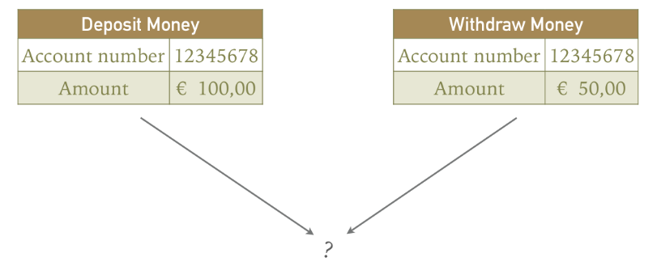
Support for concurrency
This is only necessary when the model is being updated by multiple event handlers with different models, as they can both try to update the same entry at the same time.
Example:

Slide 12
Idempotent Handler :
The worst thing that can happen is that the view's data store is temporarily out of sync.
Non-idempotent Handler :
1
event
3
event
2
Without version or id :
With version or id :
50$
Id-1
50$
tr-1
tr-1
50$
100$
tr-2
tr-2
50$
id-1
50$

Slide 13
Client applications can use views with delayed consistency
One of the problems with CQRS is that a client that updates the command side and then immediately executes the request may not see its own update. Due to the inevitable delays in the messaging infrastructure, the presentation is delayed-consistent.
The command and query module APIs allow the client to detect inconsistencies using the following approach :
The command-side operation returns a token with the ID of the published event to the client.
The client specifies this token in the request operation.
If the view has not been updated as a result of this event, the operation will return an error.
The view module may implement this mechanism using a repeat event detection system.

Slide 14
Adding and Updating CQRS Representations
Building CQRS Views with Archived Events
One problem is that the broker cannot store messages indefinitely.
So, the view cannot be built by reading all the necessary events from the message broker. Instead, the application needs to read older events archived in, say, AWS S3. This can be done with a scalable big data storage technology such as Apache Spark.
Incremental building of CQRS representations
Another problem with creating views is that it takes more and more time and resources to process all the events.
The first stage periodically computes a snapshot of each aggregation instance, given the previous snapshot and events that have occurred since it was created.
In the second step, the view is created using snapshots and any subsequent events.

Slide 15
What did we understand from this presentation?
CQRS is a pattern that helps separate write and read parts of the APP.
To develop good CQRS representation we need to think about:
Which DB to choose for our read part.
How to handle concurrency support
How to manage delayed consistency
How you will add and update new representations (views)

Slide 16
AXON
Axon - is one of the few frameworks that allow you to create flexible microservice solutions using the Event Sourcing and CQRS architectural patterns.
Event Sourcing gives us a new way of persisting application state as an ordered sequence of events. We can selectively query these events and reconstruct the state of the application at any point in time. Of course, to make this work, we need to reimage every change to the state of the application as events.
These events here are facts that have happened and can not be altered — in other words, they must be immutable. Recreating the application state is just a matter of replaying all the events.

Slide 17
NOT USE CQRS
everywhere

